Slide 1
Comparing NGS Assemblers
Salzberg et al. (2011), “GAGE: A critical evaluation of genome assemblies and assembly algorithms,” Genome Research 21, http://dx.doi.org/10.1101/gr.131383.111.
Earl et al. (2011), “Assemblathon 1: A competitive assessment of de novo short read assembly methods,” Genome Research 21:2224-41, http://dx.doi.org/10.1101/gr.126599.111.
Presented by Hershel Safer
in Ron Shamir’s group meeting
on 18/1/2012
Notes:
Note DOI (Digital Object Identifier) references.
The DOI system is for identifying content objects in the digital environment
They are used to provide current information, including where an object (or information about it) can be found on the Internet.
Information about a digital object may change over time, including where to find it, but its DOI name will not change.
The object’s owner must update the DOI pointer

Slide 2
Outline
Background
The structure of the comparisons
The data
Assessing the results
Conclusions

Slide 3
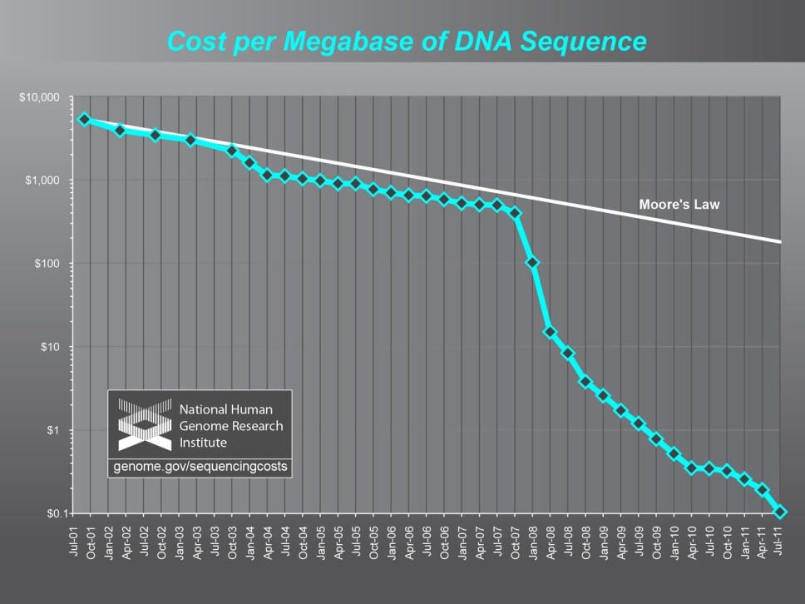
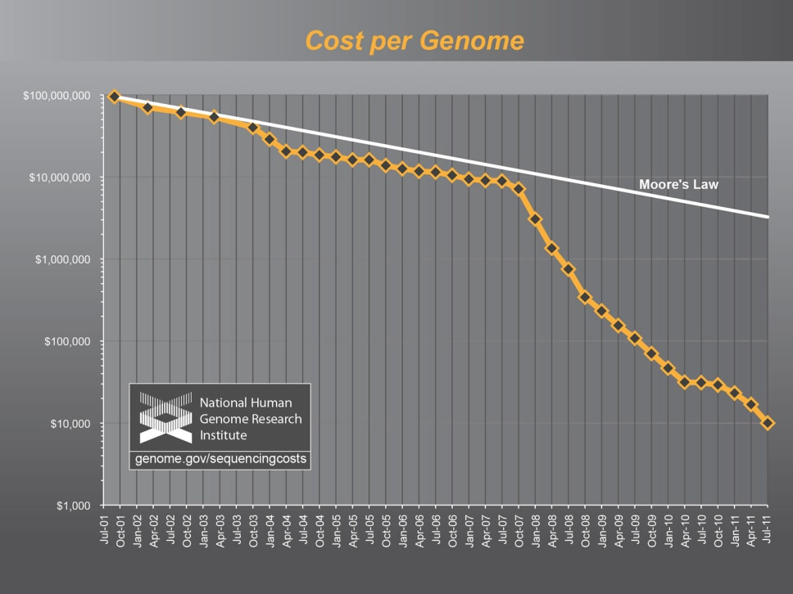
The revolution in sequencing technologies
The sequencing world is undergoing a revolution: cost is decreasing and throughput is increasing at exponential rates.
Can generate deep coverage of most species in a few days.
Cost / megabase ~ $0.10.
Cost of sequencing a human-sized genome ~ $10,000.
Notes:
Cost / megabase & cost / human-sized genome
Steep decrease started in early 2008

Slide 4
Long vs. short reads for assembly
Characteristic | Capillary sequencing | Next-gen sequencing
Read length | 300 – 1,000 bp | < 150 bp
Error rate | Lower | Higher
Cost | Higher | Much lower
Contiguity of assembly | Long | Not as long
Linking information | Often available | Less reliable
Assembling NGS data is still hard:
Deeper coverage of short-read datasets does not make up for shorter read length in terms of assembly quality.
Few people know how to design optimal NGS sequencing strategy and properly assemble the data.
Mature programs don’t work with NGS data
Notes:
Programs from Sanger sequencing can’t handle the volume of NGS reads, or don’t give good results with short reads

Slide 5
Goals in comparing NGS assemblers
What is the current state of the art of tools for assembling de novo genomic data from current sequencing technologies?
What do assemblies based on short reads look like?
Which assemblers give the best results?
What are the characteristics of assemblies from different assemblers?
What parameters should be used to run assemblers?
How can NGS assemblers be improved?

Slide 6
Goals of this talk
Discuss these papers.
Describe different approaches to comparing computational tools. The general ideas can be applied to other problems.
Emphasize the importance of defining benchmarks for comparison.
Highlight ways for others to replicate results and extend them to incorporate new computational methods.

Slide 7
Outline
Background
The structure of the comparisons
The data
Assessing the results
Conclusions

Slide 8
Approaches of the two comparisons
Genome Assembly Gold-Standard Evaluations (GAGE): Real sequence data
Captures real patterns of errors in data.
Captures real patterns of variability in genomes.
All assemblies done by authors
Assemblathon: Simulated genome & sequences
No homology to known genomes; allows fair test.
Able to tailor genome to allow for wide participation.
Knowledge of haplotypes is useful for assessing results.
Assemblies done by multiple groups

Slide 9
The Assemblathon groups
Notes:
Assemblathon: 17 groups, 41 assemblies, 15 programs
Beta = highly diverged, homologous genome
Last three lines represent assemblies run by Assemblathon organizers using common assemblers
The results are about teams as well as about assemblers
GAGE: The evaluators ran all the assemblers

Slide 10
The assemblers
Assembler | GAGE | Assemblathon |  |  | Assembler | GAGE | Assemblathon
ABySS | Y | 3 |  |  | Monument |  | 1
Allpaths-LG | Y | 1 |  |  | MSR-CA | Y
Anchor |  | 1 |  |  | OligoZip |  | 1
Bambus2 | Y | 1 |  |  | PCAP |  | 1
BWA |  | 1 |  |  | PE-Assembler |  | 1
CABOG | Y |  |  |  | Phrap |  | 1
Celera |  | 1 |  |  | Phusion2 |  | 1
CLC |  | 1 |  |  | PRICE |  | 1
Cortex_con_rp |  | 1 |  |  | SGA | Y | 2
Curtain |  | 1 |  |  | SOAPdenovo | Y | 2
Kiki |  | 1 |  |  | Velvet | Y | 2
Meraculous |  | 1
Notes:
23 assemblers
GAGE = Used in GAGE comparison
Assemblathon = # groups (not counting organizers) that used this assembler. Note the variety!

Slide 11
Notes about the assemblers
Most (all?) of the assemblers are open source.
Assemblers were run with multiple parameters to find the best settings for each case.
Most assemblers are multistage pipelines. Some have modular components that can be mixed and matched. Some assemblers even use pieces of other assemblers. For these studies, entire pipelines were used, except for cleaning the reads in GAGE.

Slide 12
Replicating and extending the comparisons
“Recipes” for replicating this work and working with other datasets are available on the projects’ websites:
GAGE: http://gage.cbcb.umd.edu
Assemblathon: http://assemblathon.org/
GAGE provides:
Detailed instructions for running each assembler.
Assemblathon provides:
Each group created its own assemblies; details of how they did this are not provided.
Code and overview instructions for analyzing the assemblies.
Notes:
None of the major genome projects provided full details about how the assemblies were created.

Slide 13
Outline
Background
The structure of the comparisons
The data
Assessing the results
Conclusions

Slide 14
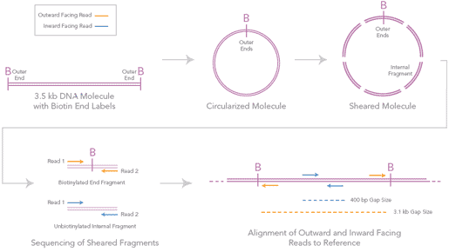
Definitions: Paired ends and mate pairs
Paired ends are two sequences read directly from opposite ends of a single DNA molecule. The approximate length of fragments in a DNA library is known; this yields the approximate distance between paired ends.
~300 bp
Mate pairs (Illumina terminology) are two sequences from opposite ends of a longer DNA molecule (2–5 kb insert).
50 bp
50 bp
~200 bp
One end is biotinylated.
The molecule is circularized and sheared.
Biotin-labeled fragments are affinity purified.
Paired ends are sequenced.
Approx. distance between mate pairs is known.
http://www.eurofinsdna.com

Slide 15
Characteristics of sequencing data
Characteristics of sequencing data that can affect the choice of assembler:
The technology for generating the reads.
The read lengths.
The error characteristics of the reads.
Whether and how the reads are “paired.”
The availability of a reference genome for the same or a homologous species.
Both papers use Illumina HiSeq data. Comparing assemblers using other sequencing technologies may yield different results, but the same methodologies can be applied for the comparison.

Slide 16
The data: GAGE
Species | Staphylococcus aureus | Rhodobacter sphaeroides | Homo sapiens chr 14 | Bombus impatiens
Size (Mb) | 2.90 | 4.60 | 88.29 | ~250
Read length | 101, 37 | 101 | 101 | 124
# chromosomes | 1 chr, 1 plasmid | 2 chr, 5 plasmid | 1 chr | 16 or 32 chr
Reference genome? | Yes | Yes | Yes | No
Library 1: # reads | 1,294,104 | 2,050,868 | 36,504,800 | 303,118,594
Fragment size | 180 | 180 | 155 | 400
Library 2: # reads | 3,494,070 | 2,050,868 | 22,669,408 | 129,118,270
Fragment size | 3,500 | 3,500 | 2,280 – 2,800 | 3,000 – 4,000
Library 3: # reads |  |  | 2,405,064 | 65,081,280
Fragment size |  |  | 35 kbp | 8 kbp
Notes:
Whole-genome shotgun data from 4 species
The first two are bacteria
Human: Just one (relatively small) chromosome. Some assemblers cannot accommodate the entire Hs genome, and others would take too long to assemble it.
The last is the bumblebee. Queens and workers are diploid and have 32 chr. Male drones are haploid and have 16 chr.
Reference genomes were generated using Sanger capillary sequencing

Slide 17
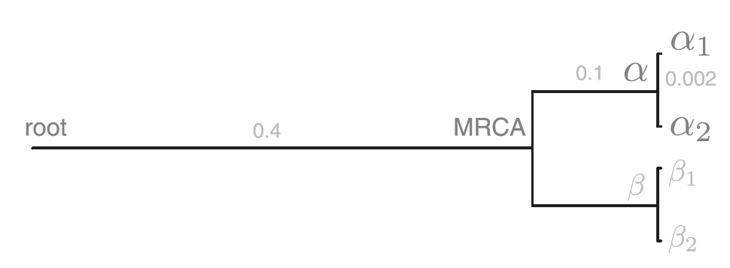
The data: The Assemblathon genome
The idea: A novel diploid genome, with nearest homologous genome significantly diverged; similar to vertebrate, but smaller.
Simulated evolution using the Evolver toolset.
Two lineages, ~50 my divergence
Split into haplotypes
+ ~1 my divergence
Homo sapiens chr. 13:
Sequence + annotation
Diploid genome
to be assembled
Outgroup: Distantly
homologous genome
Evolution ~200 million years (my)
Most recent common ancestor
α₁, α₂ haplotypes are 112.5 Mb.
3 chromosomes: 76.3, 18.5, 17.7 Mb.
Notes:
Hs13: Homo sapiens chromosome 13
Long burn-in of 200 my to reshuffle sequence & annotation, to reduce similarity to known Hs13
Beta, Beta_1, Beta_2, and their annotations given to assemblers as a homologous genome. Few used this info.

Slide 18
The data: The Assemblathon reads
Developed a read simulator that models Illumina protocols and errors. None of the many existing read generators was sufficient.
Paired-end libraries with 200- & 300-bp inserts: 80x coverage
Mate-pair libraries with 3- & 10-kb inserts: 40x coverage.
Added 3 copies of E. coli sequence for ~5% contamination.
Error profile applied to each read
Error rate depends on position in sequence and underlying base. Model developed by comparing human mitochondrial Illumina reads to reference genome.
Oops: Applied in wrong direction, so error rate was higher at beginning of read than at end. Problem only for one group.
Notes:
Participants were told of existence of contamination, but not source or amount.
Some groups filtered out the E. coli; some assembled it (preferably into contigs separate from the genome).
Text discusses limitations of error model and suggested improvements.

Slide 19
Cleaning the data (GAGE only)
Cleaning the data can take longer than assembly.
Quake was run on all data to fix sequencing errors. Quake looks for k-mers that occur only once or twice in the data set—these probably contain basecalling errors. The lowest-quality base is replaced to create a likely k-mer.
The Allpaths-LG error correction routine was run on most data.
Assemblers that contain their own error correction routines made additional corrections.
Cleaning data often led to much longer contigs (details not shown).

Slide 20
Outline
Background
The structure of the comparisons
The data
Assessing the results
Conclusions

Slide 21
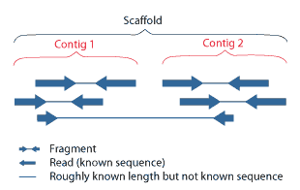
Definitions: Contigs and scaffolds
A contig is a contiguous sequence fragment, generally built up from a set of overlapping reads.
A scaffold is made up of contigs that are in the right order but not connected in one continuous stretch of sequence. Contigs are combined into scaffolds by using paired ends and mate pairs (thin blue lines in figure). Gaps between contigs represent regions of uncertainty regarding both sequence and length.
http://genome.jgi-psf.org

Slide 22
The N50 metric
The N50 value of a set of contigs is a weighted median of the contig lengths: the contig length such that 50% of the genome length is contained in contigs of size N50 or longer.
When the genome length is unknown, it is usually approximated by the sum of the contig lengths.
Example:
N50 is commonly used as a metric of assembly quality (larger is better). It is also used with scaffold lengths and other lengths.
2 2 6 7 12 18 18 23 28 31 57
Sum = 116
Sum = 116
N50 = 28

Slide 23
Assessing assembly quality: GAGE
GAGE evaluated assembly quality using:
Contig and scaffold N50
Accuracy compared to reference genome
Correcting the contigs:
Long contigs and scaffolds are preferred to short ones; however,
Contig & scaffold lengths are misleading in the presence of assembly errors, e.g., if two contigs are mistakenly joined. So
Using alignments to reference genomes, contigs were corrected by breaking them at every mistaken join and every indel > 5 bp.

Slide 24
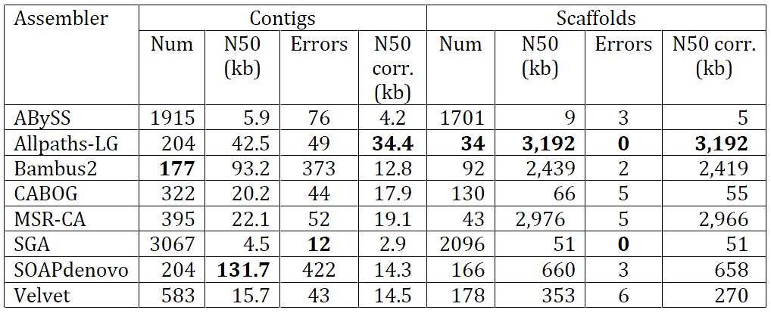
GAGE contig and scaffold lengths
Notes:
Contig errors = # misjoins + # indels of > 5bp
Scaffold errors = # misjoins
Similar tables are presented for the other genomes.
The Bee genome does not have “corrected” statistics.
Some tables not cleanly presented – split across pages without repeated headings.

Slide 25
GAGE assembly accuracy: Statistics
Notes:
All values in first table are % of true genome size
Chaff = single contig < 200 bp long
Inv = inversion – part of contig or scaffold is reversed compared to reference
Reloc = relocation – contig or scaffold is moved within chromosome
Similar tables for other two species with reference genomes.

Slide 26
GAGE assembly accuracy: Discussion
Accuracy was evaluated for the species with reference genomes.
Results are discussed in detail on a per-genome and per-assembler basis.
Common problems:
Many “chaff” contigs (specific assemblers)
Missing reference sequence (specific assemblers)
Extraneous duplications (specific assemblers)
Compressed repeats (all assemblers)
Contig misjoins (all assemblers)

Slide 27
GAGE shared errors
Comparison of indel errors among all assemblers for Hs14
Notes:
Blue bars = indels > 5bp that are unique to assembler
Red bars = errors made by at least one other assembler
Green bars = indels share by all assemblers. Maybe these are real differences between the target & reference genomes?

Slide 28
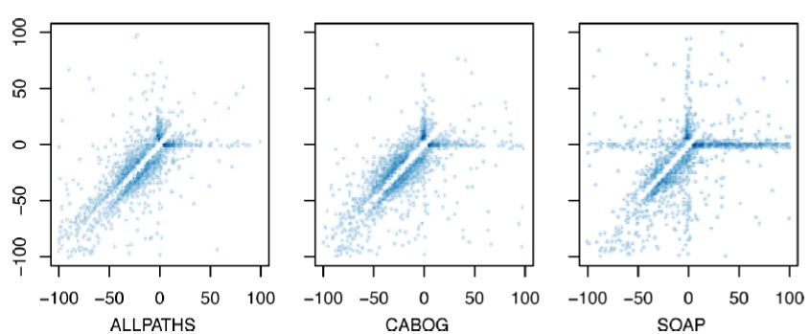
GAGE comments about assemblers
Can see that some assemblers (e.g., SOAPdenovo) build contigs more aggressively; they give longer contigs, at the expense of a larger number of indels. More conservative assemblers minimize errors, at the expense of contig length.
Each assembler has a unique profile of indel error types.
Notes:
Comparison of indel profiles for three assemblies of human chr14.
For each indel, the x-axis displays the distance between the two adjacent segments in the reference, and the y-axis displays the distance in the query. Thus, the point (100, 0) indicates a 100 bp deletion in the assembly, relative to the reference.
Deletions from the assembly lie below the line y=x, and insertions in the assembly lie above.
Rough categorization by quadrant:
- top‐ right: divergent sequence
- bottom‐right: segmental assembly deletion
- top‐left: segmental assembly insertion
- bottom‐left: tandem repeat collapse/expansion

Slide 29
Assessing assembly quality: Assemblathon
Contig and scaffold N50 and NG50
Contig path NG50: A contig path is a maximal subsequence of contigs that are consistent with one or both haplotypes.
Scaffold path NG50: A scaffold path is like a contig path, but is allowed to jump over scaffold gaps.
Structural errors within contigs and scaffolds: chromosomal joins and indels of various kinds.
Long-range contiguity (CC50): Sampled distance between two points in assembly, where points are 50% likely to be correctly aligned.
Accuracy compared to reference genome: substitution errors, copy-number errors, gene annotation
Coverage
Notes:
Assemblathon did a much more comprehensive analysis than GAGE did. Don’t have time to discuss them in depth. Will just give a sampling.
NG50 is like N50, but with the genome length = mean of alpha1 and alpha2 haplotype lengths
A contig path contains no scaffold gaps
Figures & tables in paper & this talk include only top assembly from each team. Corresponding and additional figures and tables with all assemblies are in supplement.

Slide 30
Assemblathon N50 statistics
Notes:
Various N50 statistics
Sorted left-to-right in descending order by Scaffold Path NG50
Block NG50 does not discriminate: alpha1 and alpha2 are sufficiently polymorphic (block NG50 ~ 4kb – much shorter than many assembled contigs). Need assessment methods that do not penalize assembly of haplotype-specific polymorphisms.
N50 vs. NG50: Total span of most assemblies > genome size, because of polymorphism between haplotypes.

Slide 31
Assemblathon scaffold coverage
Notes:
Stack fill plot of the coverage of scaffold paths along the three chromosomes of haplotype alpha1.
Top six rows show density plots of annotations: (CDS) Coding sequence; (UTR) untranslated region; (NXE) nonexonic conserved regions within genes; (NGE) nongenic conserved regions;
(island) CpG islands; (repeats) repetitive elements.
The remaining rows show the top-ranked assembly from each group, sorted by scaffold path length weighted overall coverage.
Each row is a density plot of the coverage, with colored stack fills used to show the length of scaffold paths mapped to a given location in the haplotype.
For example, the left-most light-orange block of the WTSI-S assembly row represents a region of haplotype alpha1 that is almost completely covered by a scaffold path from the WTSI-S assembly greater than one megabase in length.
Lots of plots of this sort in the supplementary material.
It demonstrates the substantial differences between the assemblies and shows that large, megabase regions of the haplotype can be reconstructed with assembly gaps, but without apparent error.

Slide 32
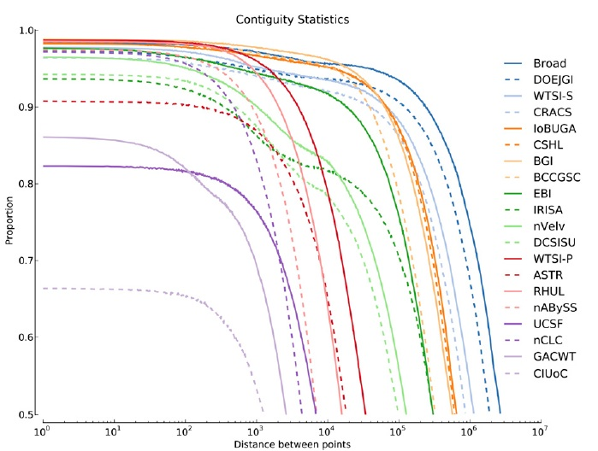
Assemblathon long-range contiguity
Look at fraction of pairs of positions in a haplotype that are in the correct order in an assembly (=correctly contiguous or CC).
Consider the proportion of CC pairs as a function of the distance between the pair in the genome. CC50 is the separation distance for the 50th percentile of CC.
Notes:
Big difference between assemblers – x-axis is log-scaled.

Slide 33
Outline
Background
The structure of the comparisons
The data
Assessing the results
Conclusions

Slide 34
Conclusions: GAGE
Data quality is more important than the choice of assembler.
The degree of contiguity of an assembly is extremely variable between assemblers.
The correctness of an assembly is also extremely variable, and is not particularly correlated with contiguity.
All assemblers exhibit errors, but some are consistently better than others.

Slide 35
Assembler ranking: GAGE
Notes:
Allpaths is consistently strong based on contig & scaffold sizes – best tradeoff between size and error rates.
MSR-CA also does well

Slide 36
Conclusions: Assemblathon
Genomes can be assembled to a high level of coverage and accuracy.
Assemblies differ quite widely between assemblers.
Assemblers exhibit tradeoffs between assessment categories.
Haplotype-aware evaluations were an important element of the comparison.
N50 statistics correlate well with path and contiguity metrics.
Various kinds of errors are not correlated.

Slide 37
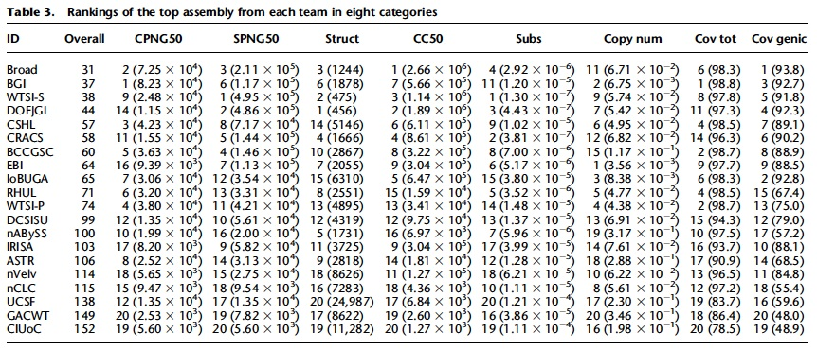
Assembler ranking: Assemblathon
Scores and ranks (using only top entry from each team) in each category. “Overall” is sum of rankings for row (possible range 8–160).
Allpaths-LG from Broad is the top performer, as in GAGE.

Slide 38
References
Keith Bradnam, “Assemblathon” presentation, http://korflab.ucdavis.edu/Datasets/Assemblathon/Assemblathon1/biology_of_genomes_assemblathon_talk.pdf.

